Slide 1


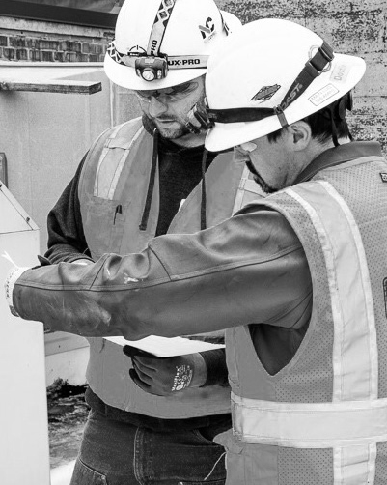

Quality work starts with quality people.
POWERED
BY
RELATIONSHIPS

